Slide 1
Session 3: Evaluate
Places that are good for the planet and for people

Slide 2
Overview
Establish: What is a 20-minute neighbourhood?
Explore: Walk round your local 20-min neighbourhood
Evaluate:
What is good about your local neighbourhood?
What is missing?
What would we like to improve?
Engage: Improving your local 20-min neighbourhood
Notes:
This is the first of four workshops, through which pupils will learn about 20 minute neighbourhoods.
The four sessions are outlined in the slide:
Establish – what is a 20 minute neighbourhood?
Explore – go out and explore your own 20 minute neighbourhood
Evaluate – is our local neighbourhood a 20 minute neighbourhood? What could be better?
Engage – how can we make change?
Overview of this session
What is a 20 minute neighbourhood?
What are the features of a 20 minute neighbourhood?
What are the benefits of a 20 minute neighbourhood?
Prepare for the next session – work out where we want to explore in our 20 minute neighbourhood.

Slide 3
Evaluating your local 20-min neighbourhood
Task: Working in groups (4-6 people) and using your surveys from last session, annotate your map showing what you found.
Annotate the map to show what you noted down during your walk.
Start with positive things – nice areas, good features
Then move onto negative things – areas that aren’t looked after, bad features
You could;
Shade areas of the map and use colour to represent different things, for example; greenspaces, areas which are busy with traffic, pedestrianised areas etc.
Add symbols to show different features you have found.
Add items to the key to explain what different colours and symbols mean.
See the next slide for some examples.

Slide 4
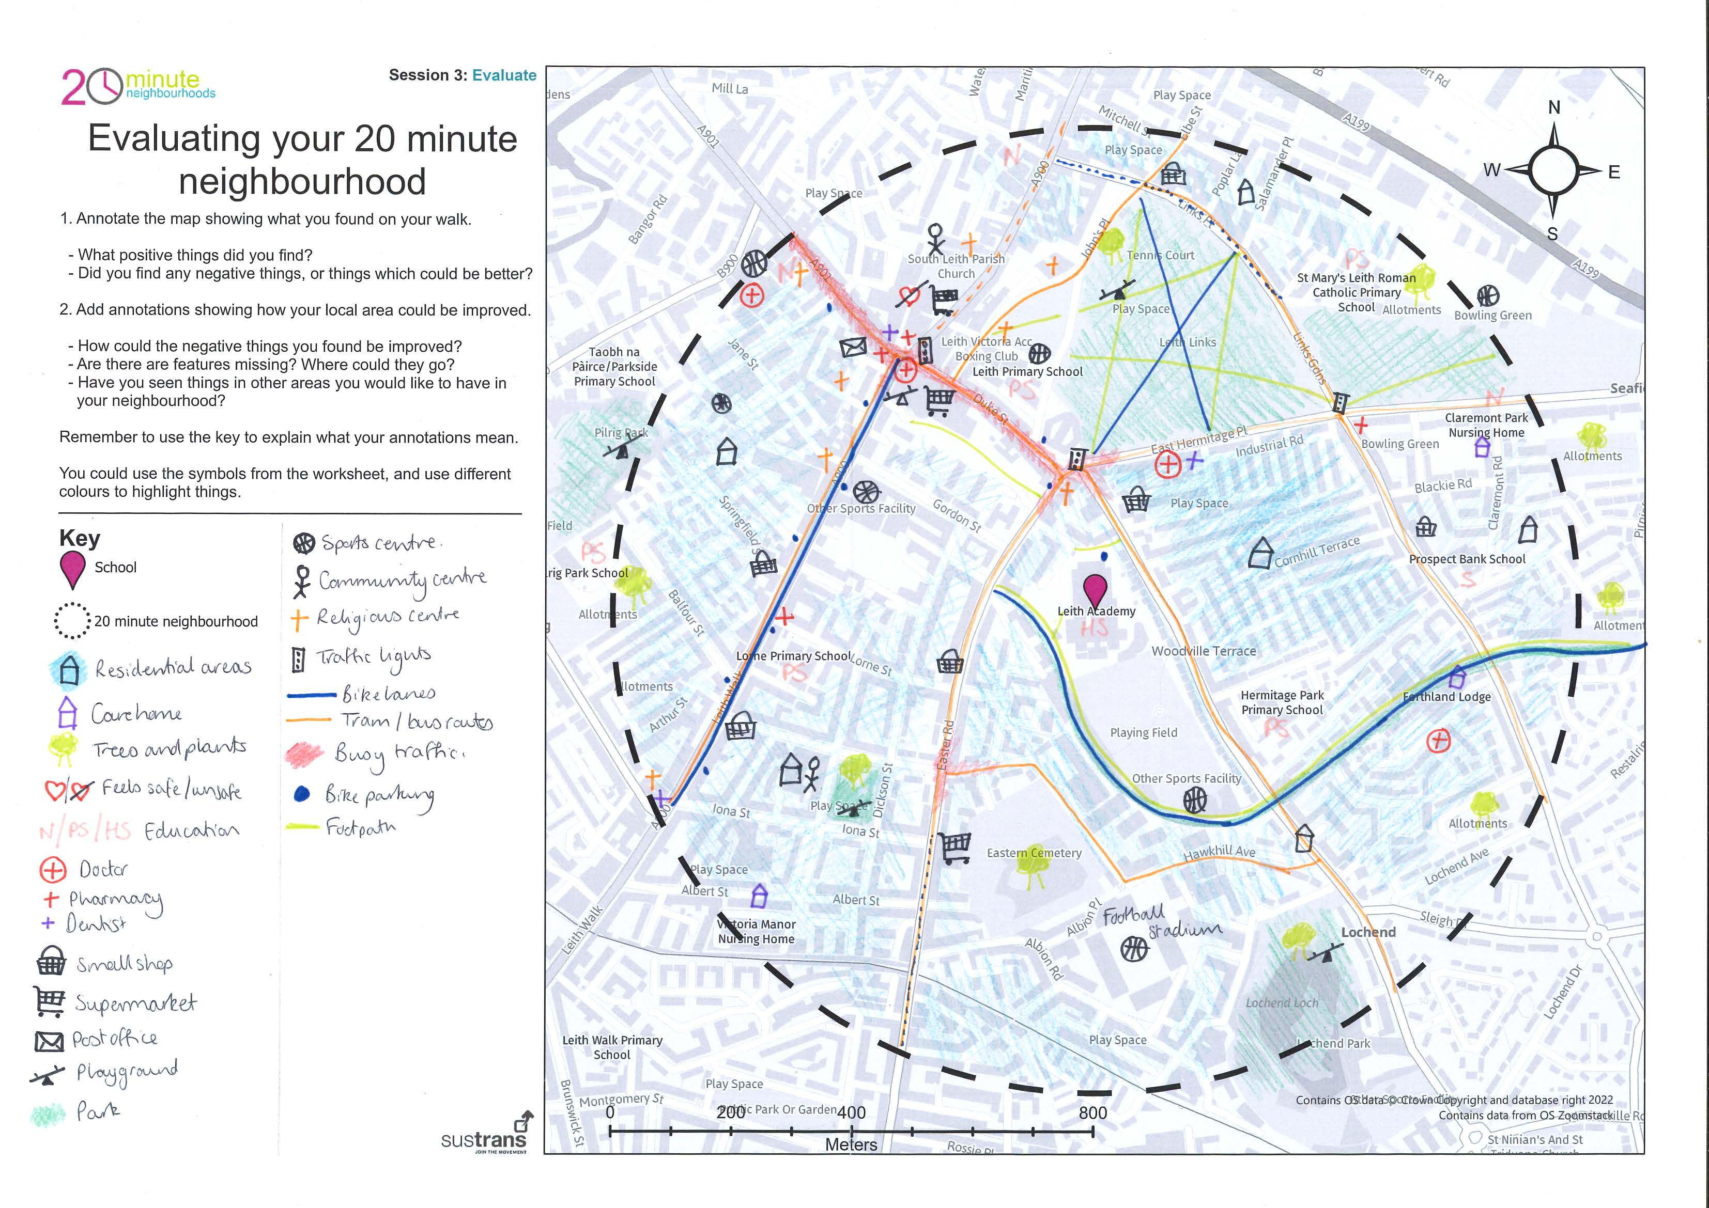

Slide 5
Evaluating your local 20-min neighbourhood
Task: Working in groups (4-6 people) and using your surveys from last session, annotate your map showing what you found.
Add annotations showing how your local area could be improved.
Think about the negative things you found – how could these be changed?
Are there any features of 20-minute neighbourhoods you haven’t found? Where could they go?
Have you seen things in other places that you particularly like?
You could;
Use post-its or annotations to add suggestions to you map
Add symbols in different colours showing what you could like to add.
Add items to the key to explain what different colours and symbols mean.
See the next slide for some examples.

Slide 6
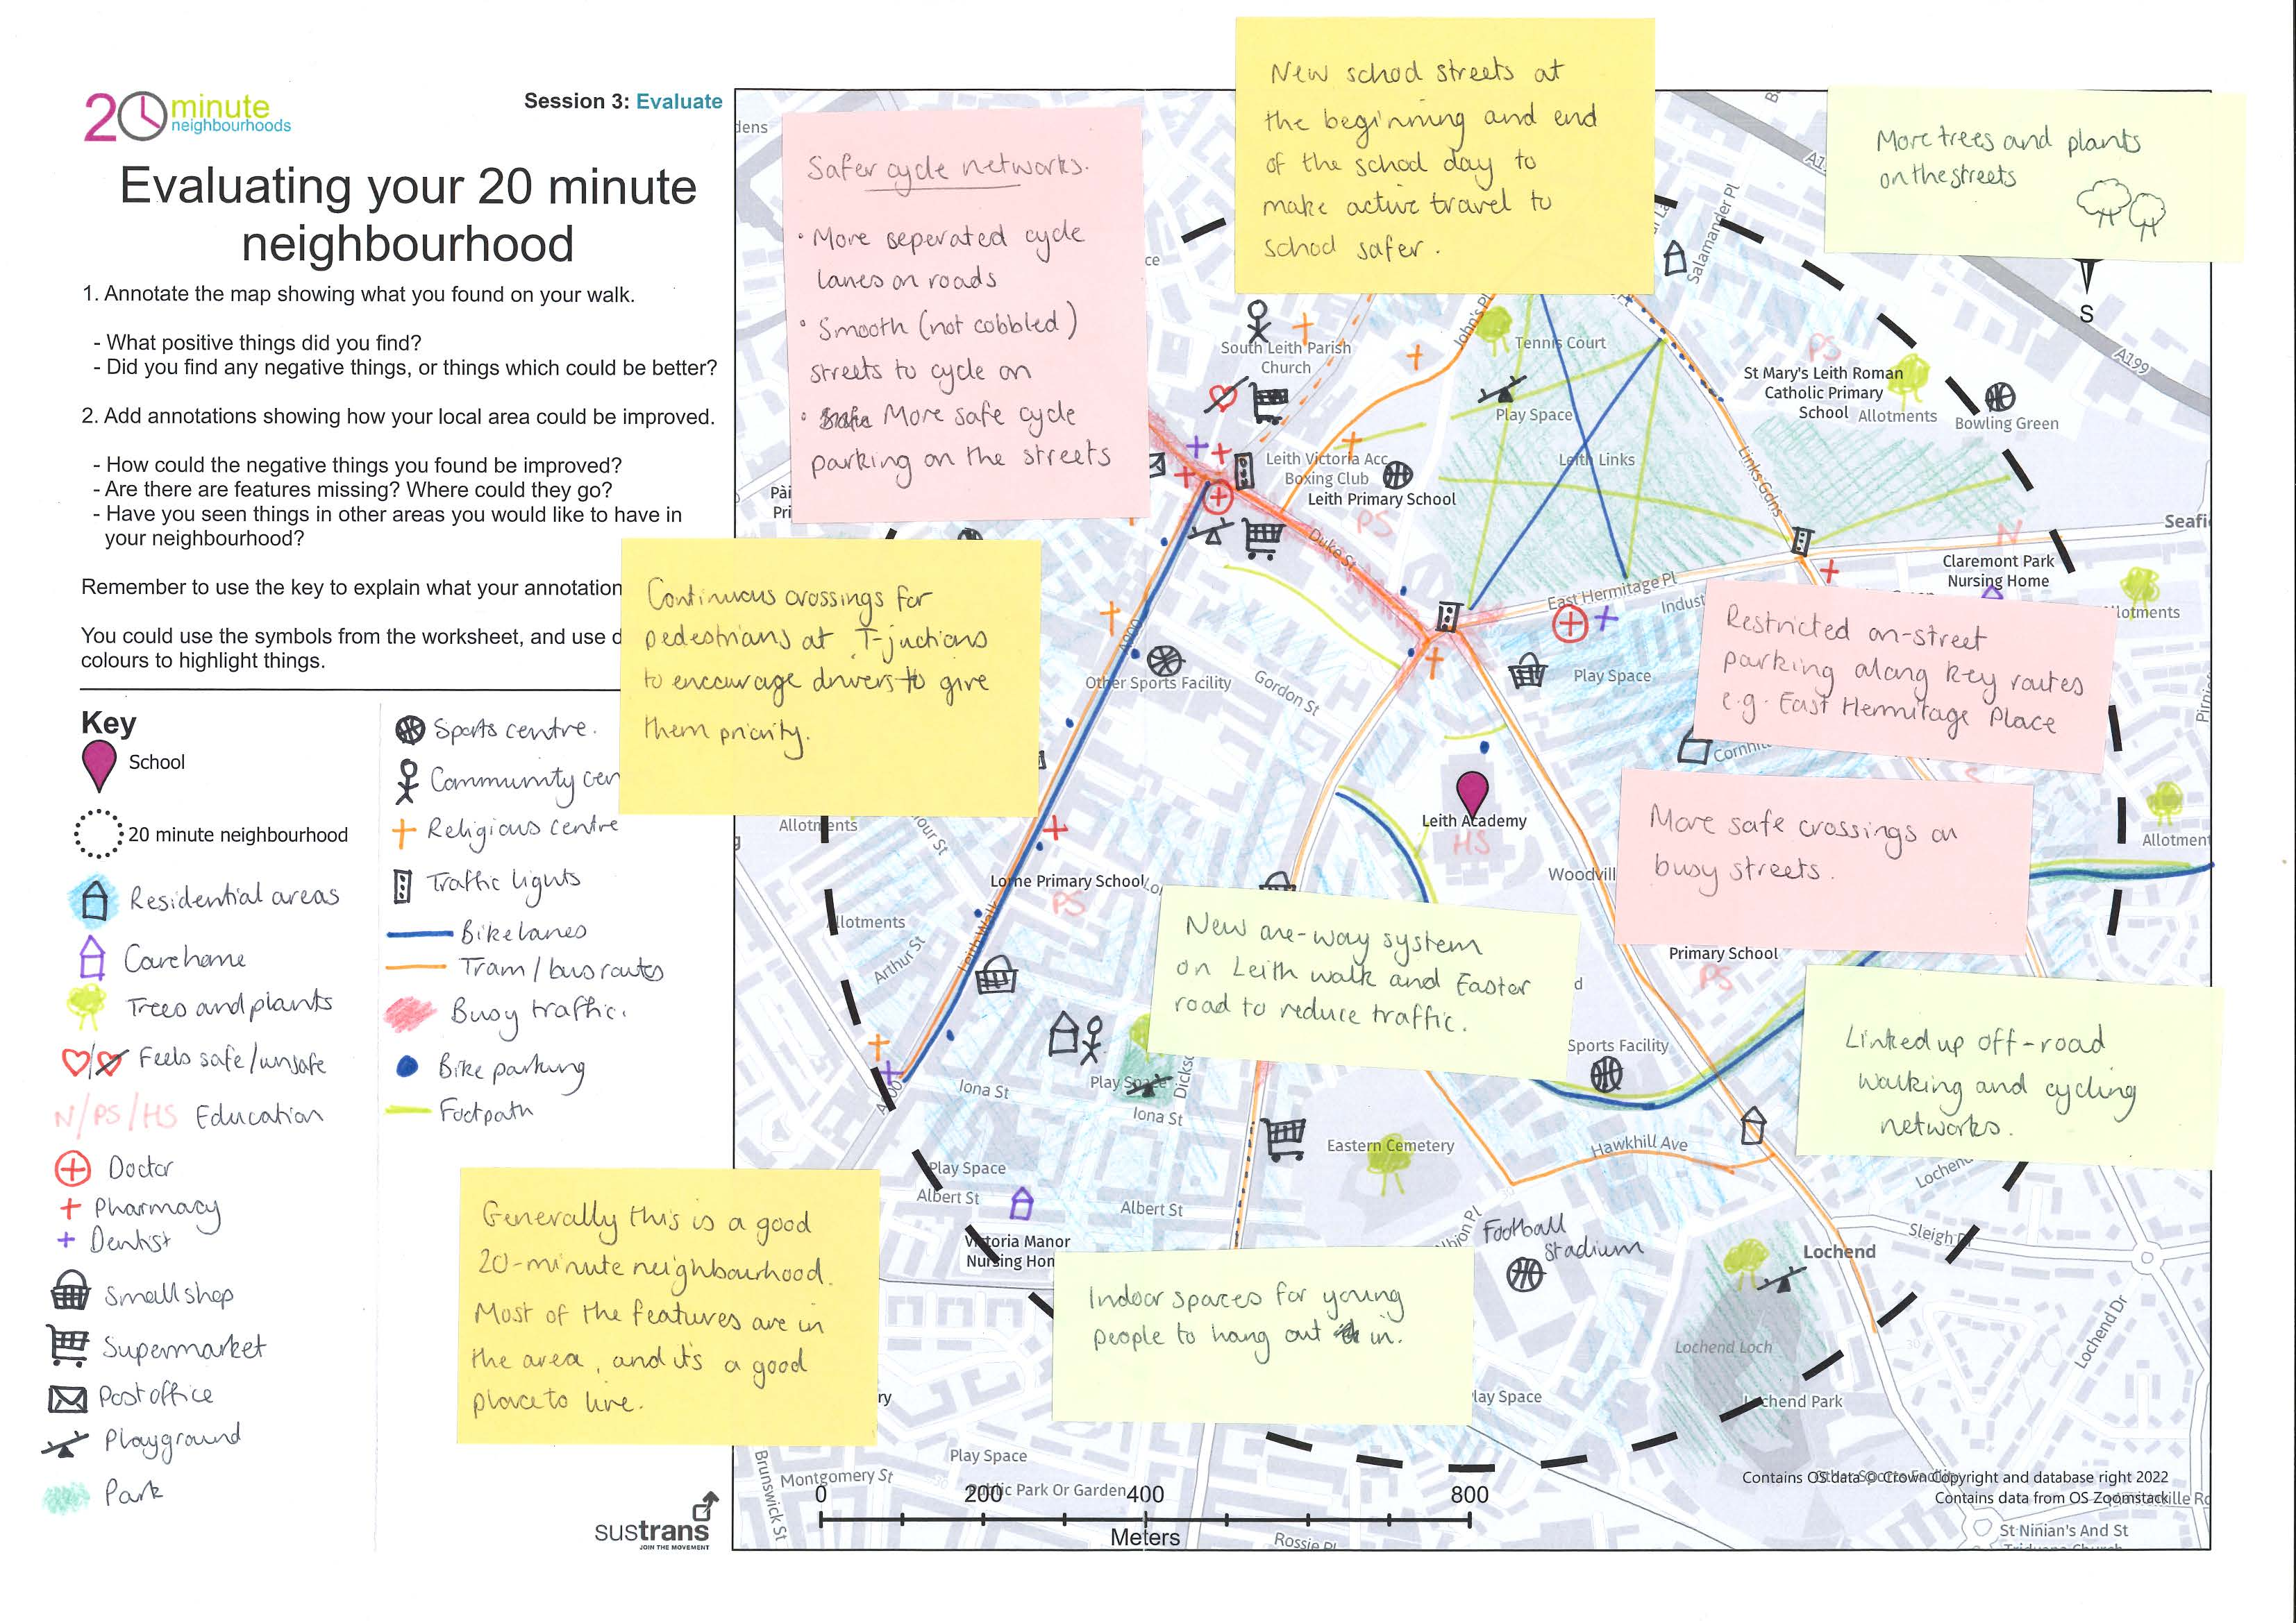

Slide 7
Feedback to the class
In each group, tell the class;
One positive thing – something you think is particularly good about your neighbourhood
One negative thing – something that you think could be better, and how you would like to see it improved
Are the any themes?

Slide 8
What do you think?
Working on your own, fill out the worksheet. There are four questions;
What was good about your neighbourhood?
What wasn’t good about your neighbourhood? Were any elements missing?
What would you like to change the most about your 20-minute neighbourhood and why? Choose one thing
How would you make this change? What would you like to see instead?
Your answers will be useful next session.

